Slide 1
Three years of dual MSG image data from operational, user and scientific perspective: possibilities and limitations
Ján Kaňák
Slovak Hydrometeorological Institute
Convection Working Group meeting 6 – 8 April 2021

Slide 2
Introduction
Stereoscopic images are produced operationally and archived at SHMÚ since December 2017 over three regions: Central Europe, Europe and Central Africa
Imagery is based on HRV and Airmass image products
Mutual parallax shifts of clouds are calculated and archived since February 2018
Because of HRV window shifts, Sun elevation and mutual satellite constellation observations of meteorological events are limited to:
  specific time slots during the day and
  to specific regions only
Archived products are used for case studies locally and can be used as quick look and offered to anyone who is interested in detailed 3D studies of cloudiness development, mainly in case of severe convection.
Presentation describes the image library of currently available dual satellite constellations of MSG satellites and examples prepared using data received by our local EUMETCast station
Notes:
https://portal.eumetnet.eu/display/CWG/CWG+Meeting+Online+6-8+April+2021 https://portal.eumetnet.eu/pages/viewpage.action?pageId=54694308

Slide 3
Part 1: Products available for the period December 2017 – September 2018
28800 frames for M3D and M3R binary files
28800 frames for Airmass North hemisphere product
14400 frames for HRV Europe (48 frames per day in average)
6000 frames for HRV Central Africa region

Slide 4
Part 2: Products available for the period October 2018 – June 2019
25920 frames for M3D and M3R binary files
25920 frames for Airmass North hemisphere product
12960 frames for HRV Europe (48 frames per day in average)
5400 frames for HRV Central Africa region

Slide 5
Part 3: Products available for the period July 2019 – December 2020 and continuing …
17280 frames for M3D and M3R binary files
17280 frames for Airmass North hemisphere product
8640 frames for HRV Europe (48 frames per day in average)
3600 frames for HRV Central Africa region

Slide 6
Left view
Base map
Right view
Combined view
HRV upper window
IR Channels/RGBs
HRV lower window

Slide 7
Details of base maps definitions:
Albers projection 4000x3000 pixels
Map central lon=15˚ lat=48˚
Resolution 1.305 km
Albers projection 4000x3000 pixels
Map central lon=0˚ lat=48˚
Resolution 3.500 km
Regular longitude-latitude grid 4000x3000 pixels
Map central lat=0˚ lon=20˚
Region 40˚x30˚
Resolution 1.113 km

Slide 8




















Limitation of the Central African region during day time 12 timeslots = 3 hours:
12 timeslots
12 timeslots
12 timeslots
Before midday
After midday
Number of timeslots available for creation the anaglyphs
4
8
12
8
4
For MSG HRV lower window (African region) totally 20 15-minutes timeframes,
but regions covered only by 4, 8 or maximum 12 frames (3 hour of cloud development)

Slide 9
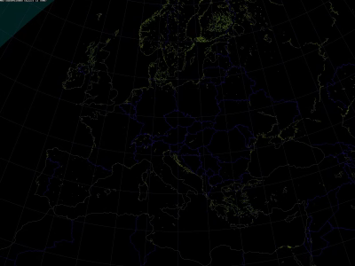
Areas over Europe during the day covered by dual MSG observations:
EUMETSAT changes in timing of upper HRV
window during day decreased coverage !!!
From 06:00
To 09:30
From 09:45
To 13:45
Movement of upper HRV window
during the day limits the regions
covered by dual satellite observations:
From 14:00
To 16:45
From 17:00
To 18:00

Slide 10
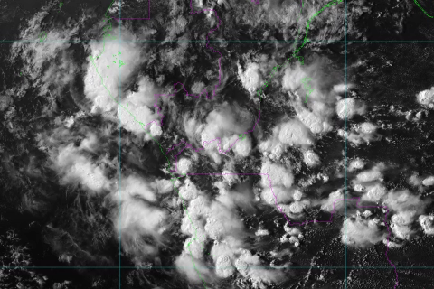
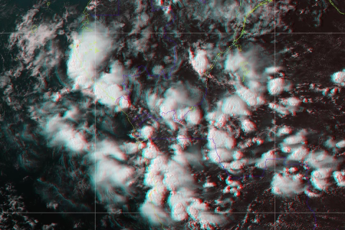

Case 20210403 Central Africa different RGBs versus anaglyphs

Slide 11
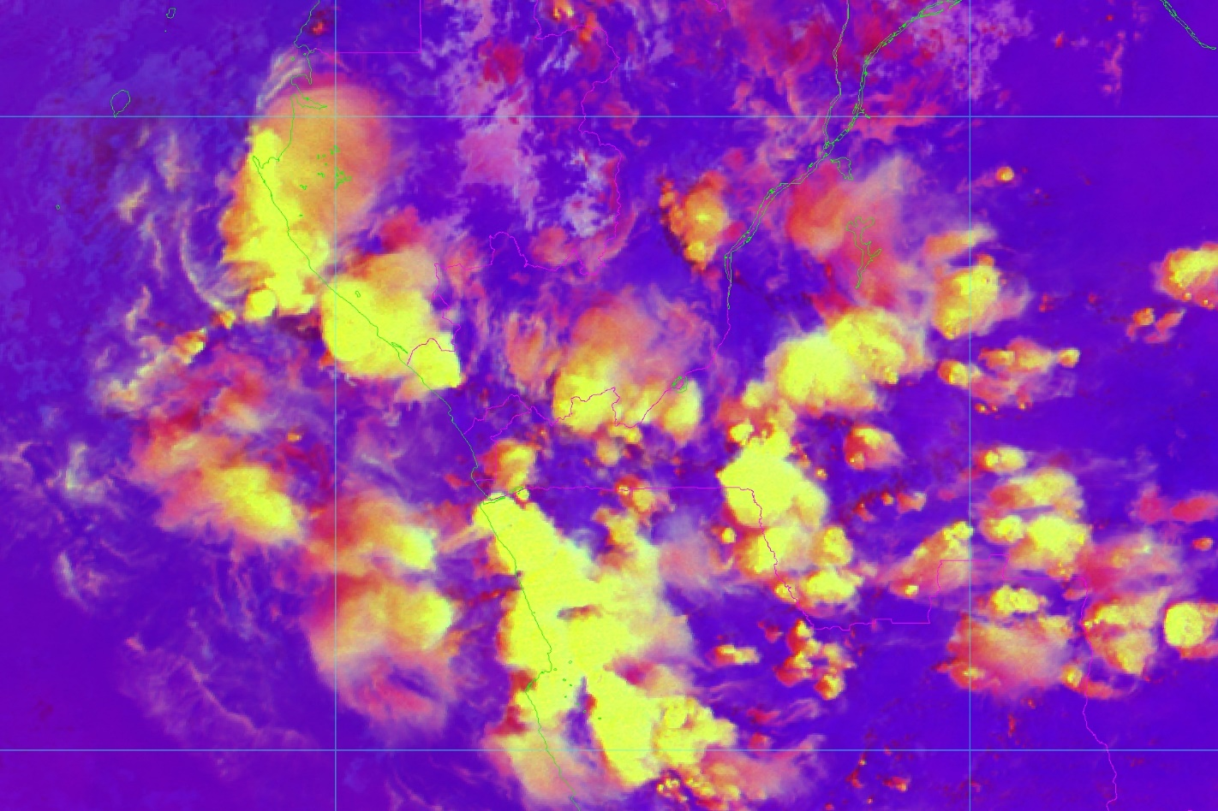
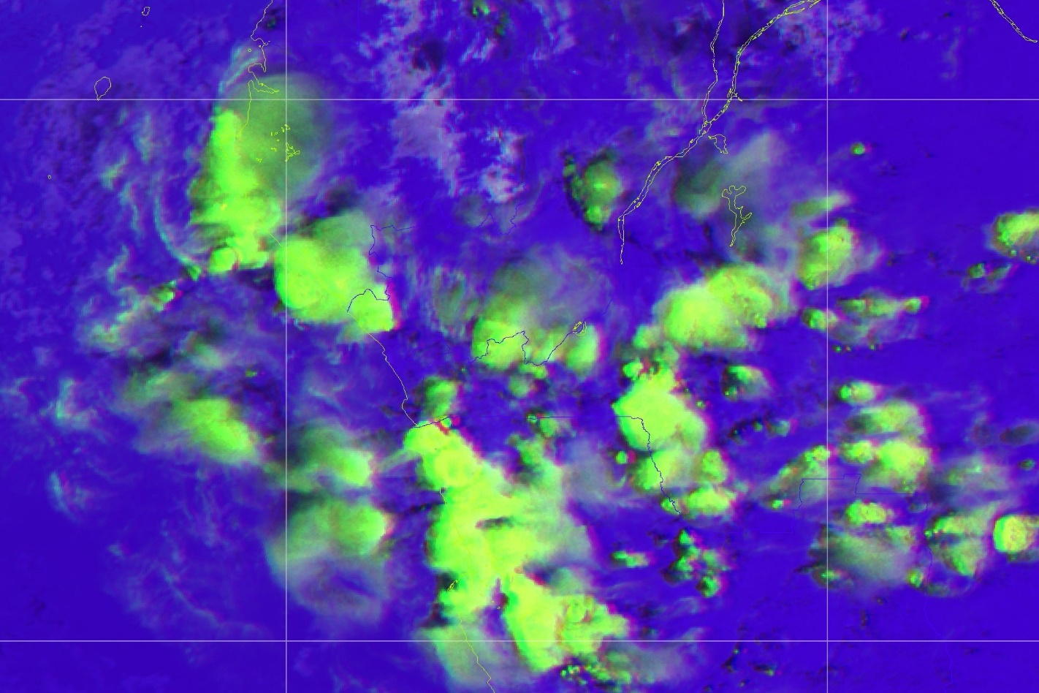
Case 20210403 Central Africa different RGBs versus anaglyphs
Microphysical information from RGBs as Day Microphysics,
Convective Storms RGB, … is limited in anaglyphs or
practically disappear because of the application of
anaglyph method!

Slide 12
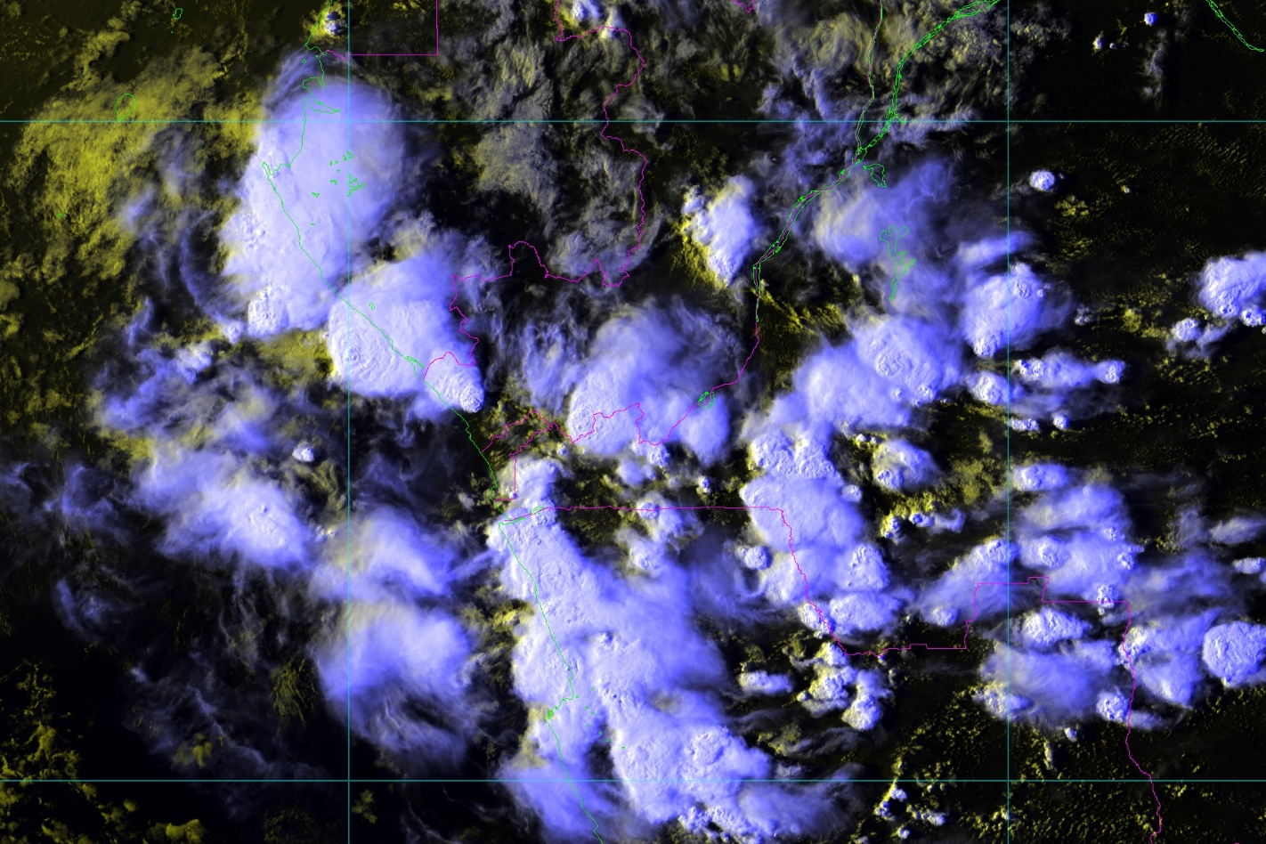
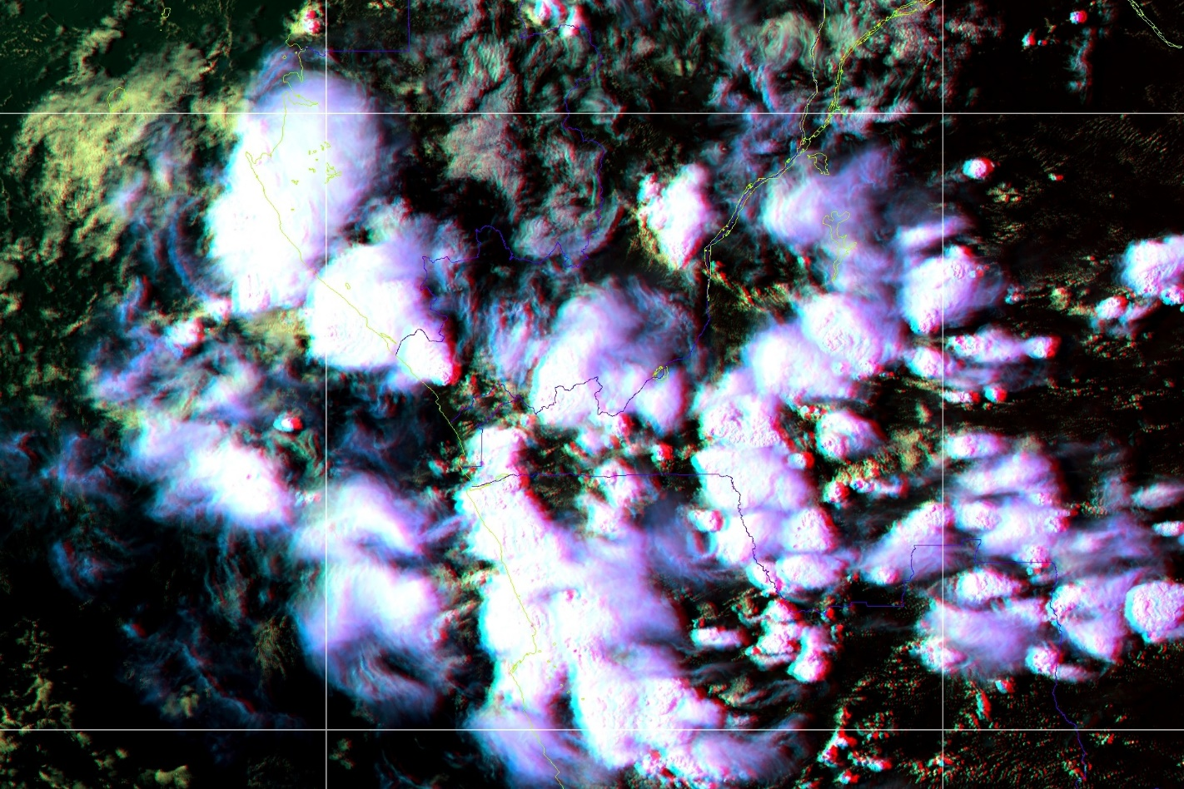
Case 20210403 Central Africa different RGBs versus anaglyphs
Features:
Overshooting tops in high resolution
High cirrus arc (gravity wave) in the top-left corner westerly from the biggest storm
Gust front in the upper-central part of this image sequence

Slide 13
Technical possibilities how to observe 3D stereoscopic imagery:
Single switching between images:
We can observe the effects of parallax
shifts for very high level clouds
Exact estimation of parallax shifts
Is possible numerically, e.g. by methods
Already presented in CWG or
At EUMETSAT conferences:
EUMETSAT Meteorological Satellite
Conference 2018, Tallinn:
FULLY AUTOMATED QUANTITATIVE
ESTIMATION OF CLOUD TOP HEIGHT
USING STEREOSCOPIC METEOSAT
SATELLITE OBSERVATIONS
LEFT
RIGHT

Slide 14
Technical possibilities how to observe 3D stereoscopic imagery:
Professional 3D monitors or
Quite simple and cheap Virtual Reality viewers base on smartphones:
Advantage:
Full color perception in case of RGB products!!!

Slide 15
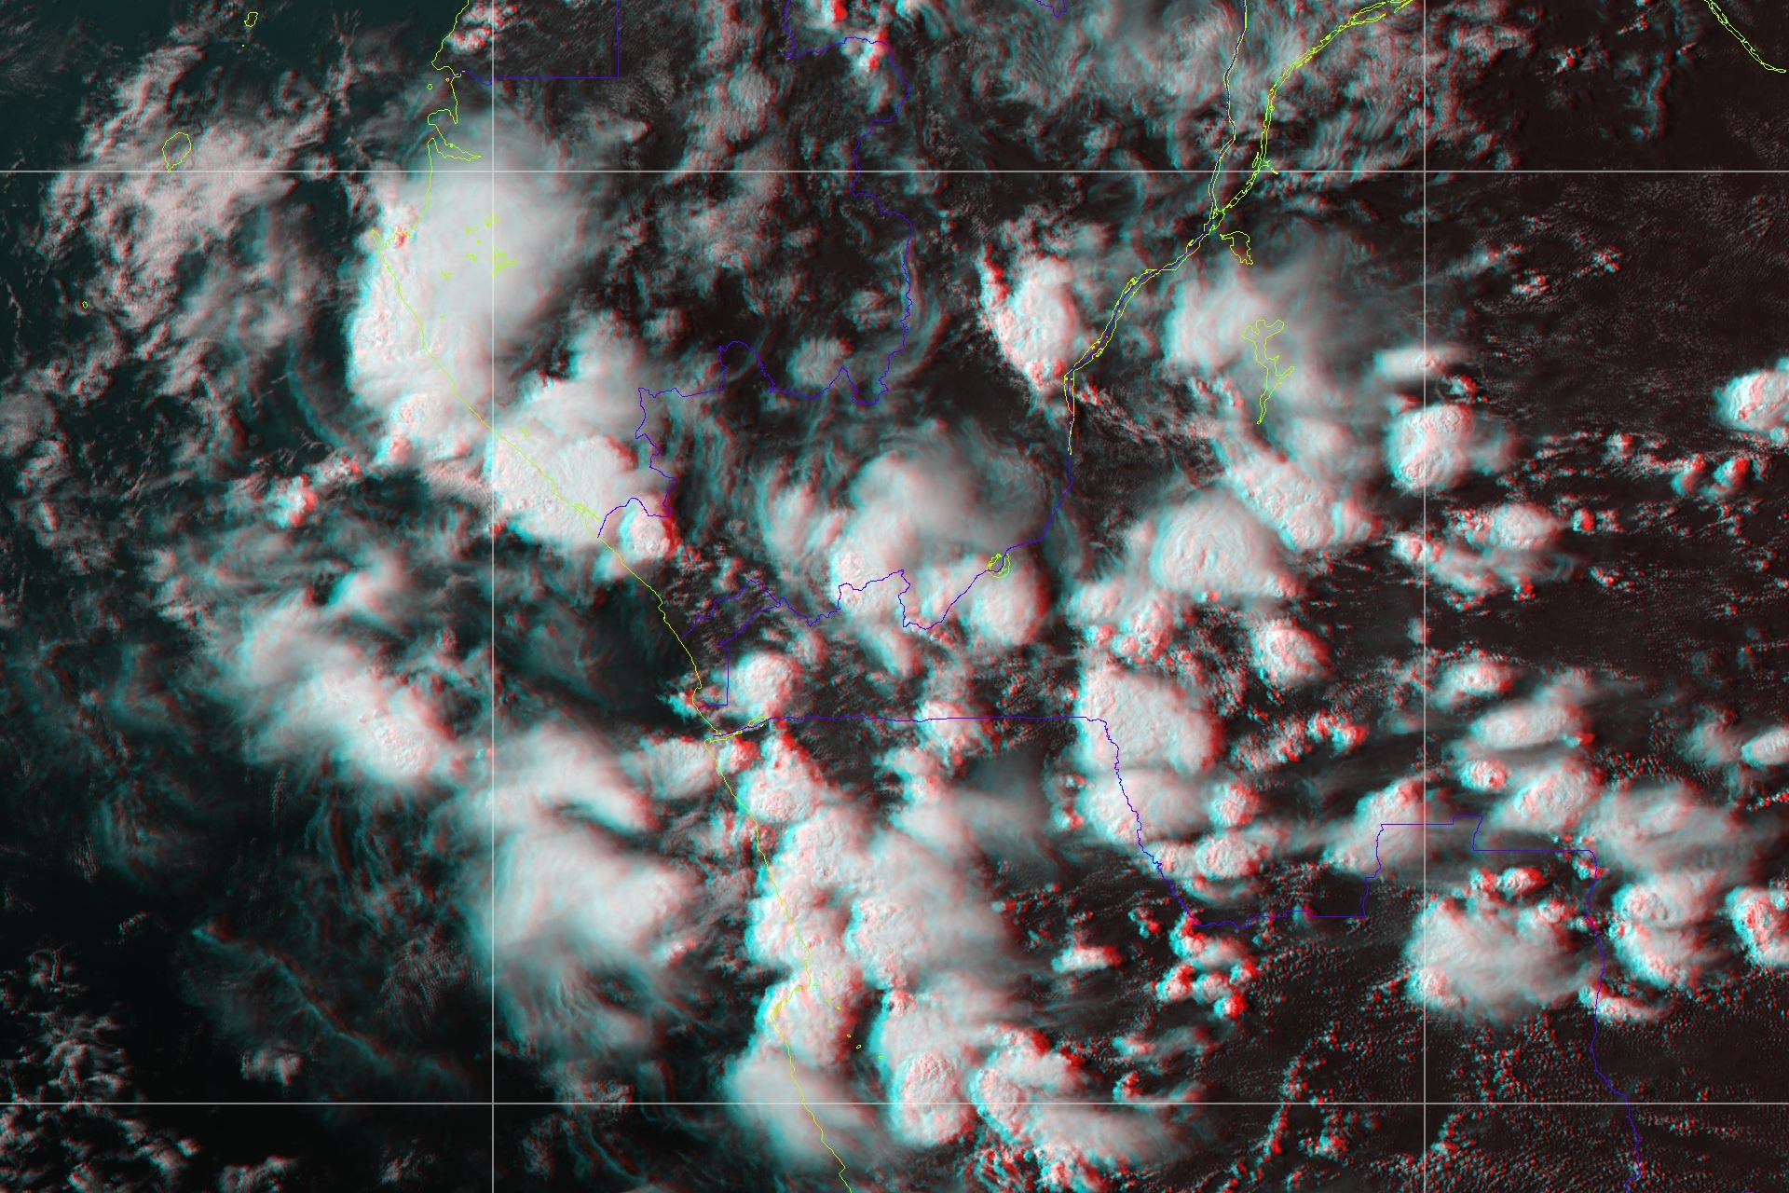
Technical possibilities how to observe 3D stereoscopic imagery:
Anaglyph images and red/blue glasses:
Problem:
Missing full color perception
in case of RGB products

Slide 16
Different RBGs and their usability as anaglyphs
Standard RGB images:
24hMicrophiscs
Airmass
Cloud Phase
Cloud Types
Daily Cloud Phase Distinction
Day Microphysical
Day Solar
Fire Temperature
Natural Colors
Natural Colors White
Natural True Colors
Night
Night Low Clouds
Night Microphysical
VIS-IR
Volcanic Ash

Slide 17
Different RBGs and their usability as anaglyphs
Anaglyph RGB images:
24hMicrophiscs
Airmass
Cloud Phase
Cloud Types
Daily Cloud Phase Distinction
Day Microphysical
Day Solar
Fire Temperature
Natural Colors
Natural Colors White
Natural True Colors
Night
Night Low Clouds
Night Microphysical
VIS-IR
Volcanic Ash
Problem:
Missing full color perception
in case of RGB products

Slide 18
Different RBGs and their usability as anaglyphs
List of RGB images:
What can we learn from the comparison of standard an anaglyph RGB images:
Red color is reduced significantly because of anaglyph’s algorithm, therefore clouds displaying at standard RGB in red, appear black in anaglyph
Some RGBs appear similar in anaglyphs
  Natural colors, Natural white, True colors
  Cloud phase, Day solar, VIS-IR, Volcanic ash
3D cloud height perception helps user to recognize more clearly between snow, low level clouds, fog in contrast with high thick cirrus clouds
3D cloud height perception helps to recognize storm top features and better localize anvil cirrus clouds extension
24hMicrophiscs
Airmass
Cloud Phase
Cloud Types
Daily Cloud Phase Distinction
Day Microphysical
Day Solar
Fire Temperature
Natural Colors
Natural Colors White
Natural True Colors
Night
Night Low Clouds
Night Microphysical
VIS-IR
Volcanic Ash
OK

Slide 19
Final remarks
If imagery is properly georeferenced, then:
  we can automatically
    estimate lower cloud tops in convection initiation phase
    and estimate CTH trends in time
    we can obtain anvil layer height in convection mature phase
  we can manually
    detect overshooting tops
    make parallax-corrected location of OT
    measure absolute OT height
Image library available at SHMÚ since 2017 can be freely provided to anyone who want to do the first quick look into 3D images. On the base of this SHMU offers reprocessing of any MSG1/MSG4 HRIT data for selected region in the maximum space and time resolution and to provide any RGBs which have to be studied with the aim of cloud top structures in 3D interpretation. Also SHMU can reprocess calculations of mutual parallax shifts for requested cases.

Slide 20
Final remarks
Technical problems are the biggest limitation in exploitation
of dual satellite observations.
The main goal:
To watch full-color RGB images in high resolution in smooth animation
without loss of color, without the need for restrictive aids
such as heavy and uncomfortable glasses.
Lot of colleagues in their presentations provided excellent methods of preparation
the perfect RGB products with brilliant colors, but:
Still a persistent problem:
Can be solvable 3D displaying by virtual reality devices for convenient user utilization?
Thank you for attention!

